Slide 1
Deep Learning Lab 9:
Neural Networks from Scratch & TensorFlow 101
DataLab
Department of Computer Science,
National Tsing Hua University, Taiwan

Slide 2
Outline
Neural Networks from Scratch
Why TensorFlow?
Environment Setup
TensorFlow 2 Quickstart
Dataset Preparation
Building Model via Sequential API, Functional API, and Model Subclassing
Better performance with tf.function
Customize gradient flow by tf.custom_gradient

Slide 3
Outline
Neural Networks from Scratch
Why TensorFlow?
Environment Setup
TensorFlow 2 Quickstart
Dataset Preparation
Building Model via Sequential API, Functional API, and Model Subclassing
Better performance with tf.function
Customize gradient flow by tf.custom_gradient

Slide 4
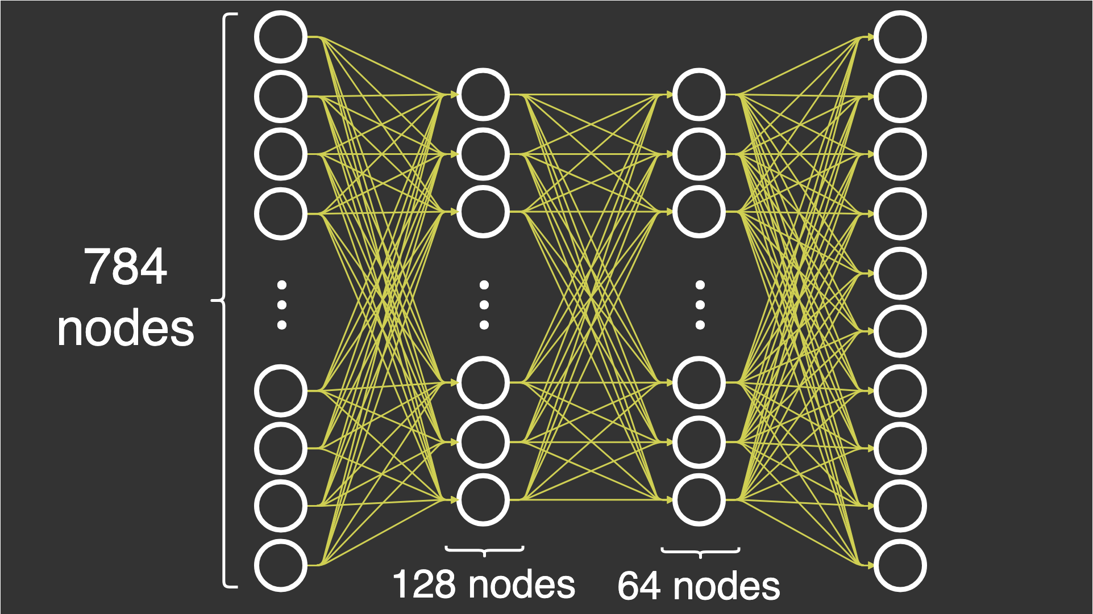
Neural Networks from Scratch
In this lab, you will learn the fundamentals of how you can build neural networks without the help of the deep learning frameworks, and instead by using NumPy

Slide 5
Neural Networks from Scratch
Creating complex neural networks with different architectures with deep learning frameworks should be a standard practice for any Machine Learning Engineer and Data Scientist
But a genuine understanding of how a neural network works is equally as valuable

Slide 6
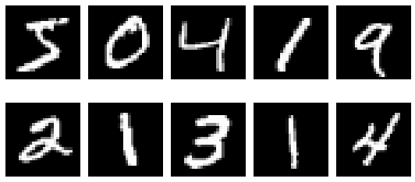
Model Architecture
We are going to build a deep neural network with 3 layers in total: 1 input layer, 1 hidden layers and 1 output layer
All layers will be fully-connected
In this tutorial, we will use MNIST dataset
MNIST contains 70,000 images of hand-written digits, 60,000 for training and 10,000 for testing, each 28x28=784 pixels, in greyscale with pixel-values from 0 to 255

Slide 7
Model Architecture
To be able to classify digits, we must end up with the probabilities of an image belonging to a certain class
Input layer: Flatten images into one array with 28x28=784 elements. This means our input layer will have 784 nodes
Hidden layer: Reduce the number of nodes from 784 in the input layer to 64 nodes, so there’s 64 nodes in hidden layer
Output layer: Reduce 64 nodes to a total of 10 nodes, and we can evaluate them against the label. The label is in the form of an array with 10 elements, where one of the elements is 1, while the rest is 0

Slide 8
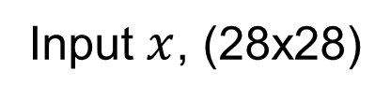
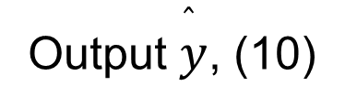
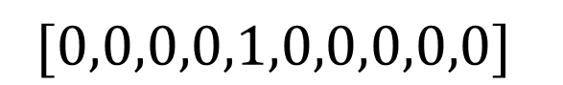
Model Architecture
Input Layer (Flatten)
Hidden Layer, 784x64
Output Layer, 64x10

Slide 9
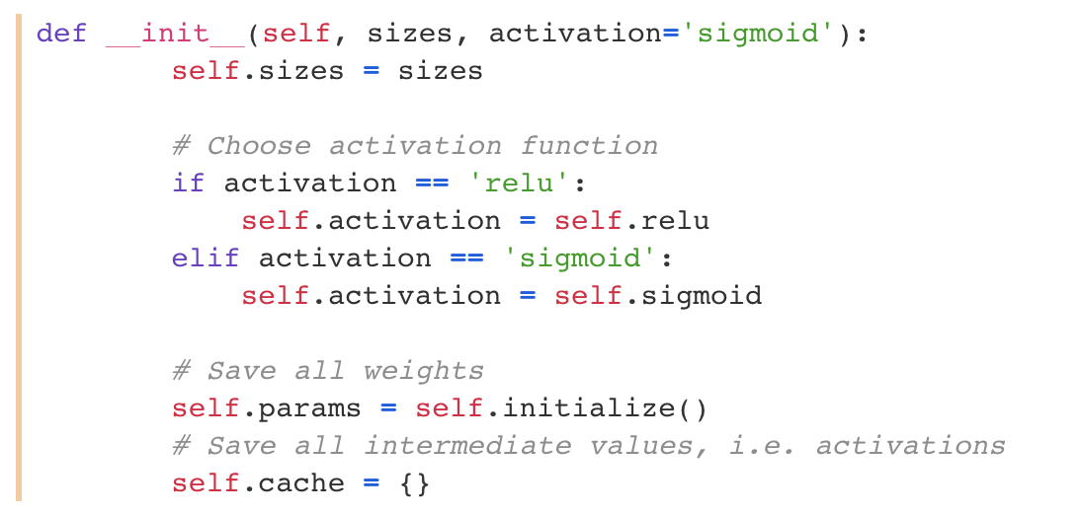
Model Architecture
When instantiating the DeepNeuralNetwork class, we pass in an array of sizes that defines the number of activations for each layer
This initializes the class by the init function

Slide 10
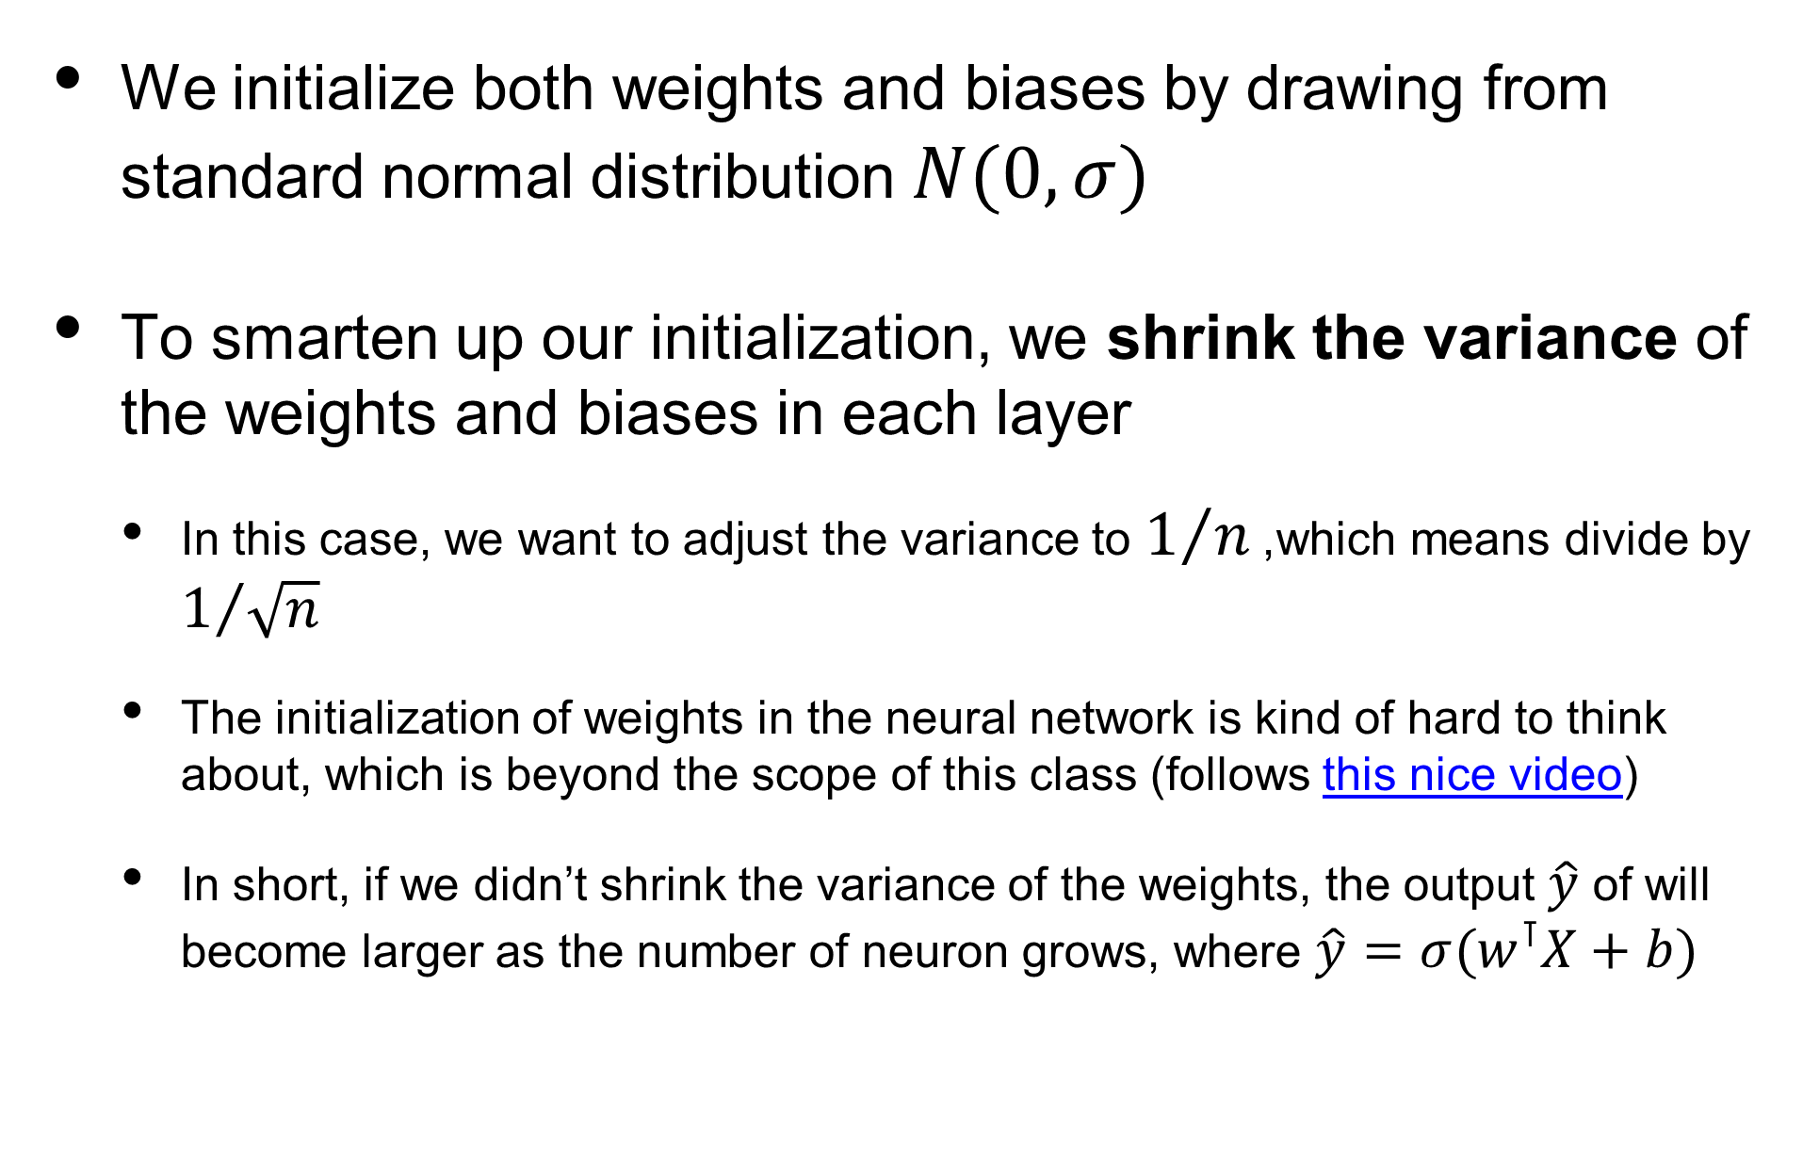
Initialization

Slide 11
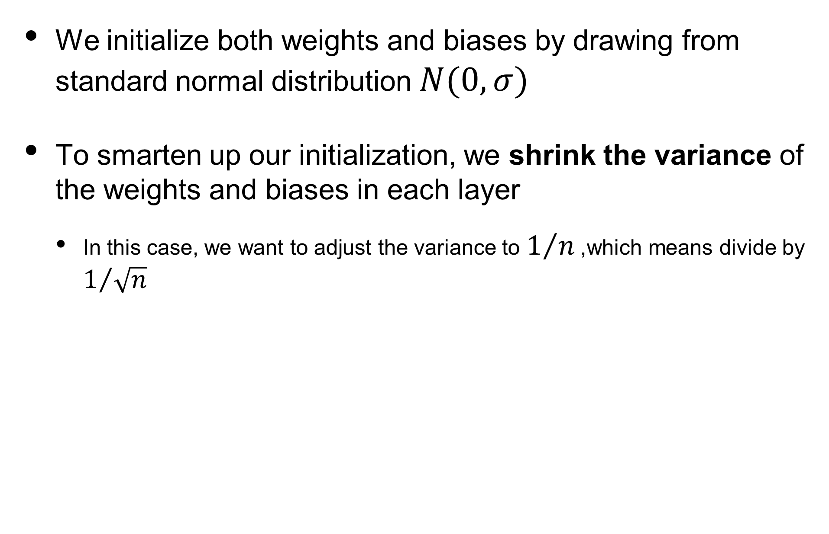
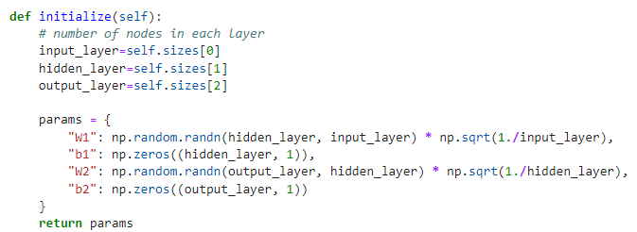
Initialization

Slide 12
Feedforward
The forward pass consists of the dot operation, which turns out to be just matrix multiplication
We have to multiply the weights by the activations of the previous layer, and then apply the activation function to the outcome
In the last layer we use the softmax activation function, since we wish to have probabilities of each class, so that we can measure how well our current forward pass performs

Slide 13
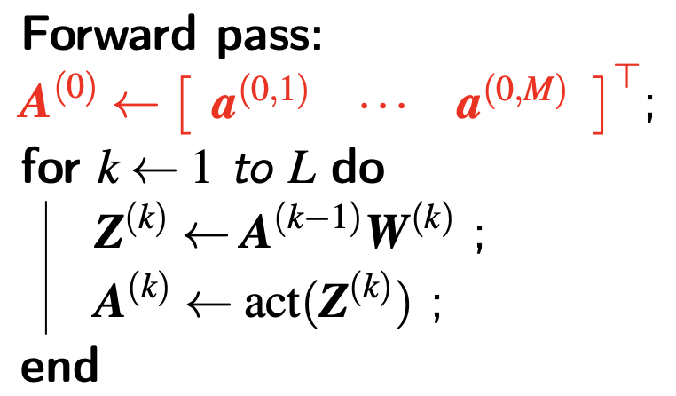
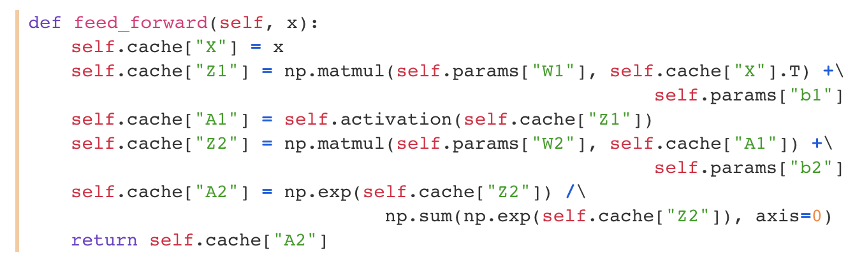

Slide 14
Activation Functions
One magical power in deep neural networks is the non-linear activation functions
They enable us to learn the non-linear relationship between input and output

Slide 15
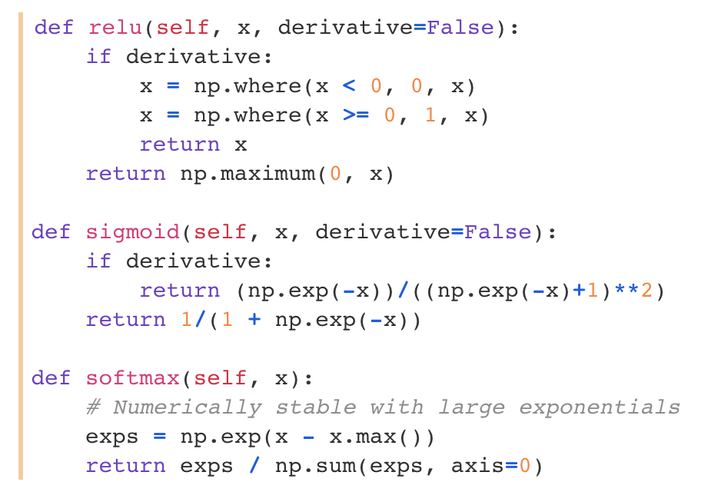
Activation Functions
We provide derivatives of activation functions, which are required when backpropagating through networks
As you have learned in the earlier lecture, a numerical stable version of the softmax function was chosen

Slide 16
Backpropagation
Backpropagation, short for backward propagation of errors, is key to supervised learning of deep neural networks
It has enabled the recent surge in popularity of deep learning algorithms since the early 2000s
The backward pass is hard to get right, because there are so many sizes and operations that have to align, for all the operations to be successful

Slide 17
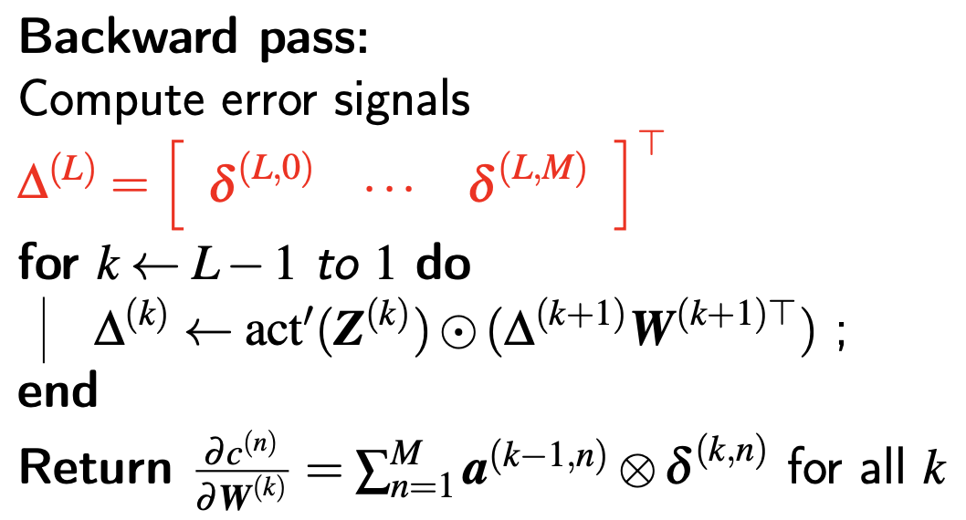
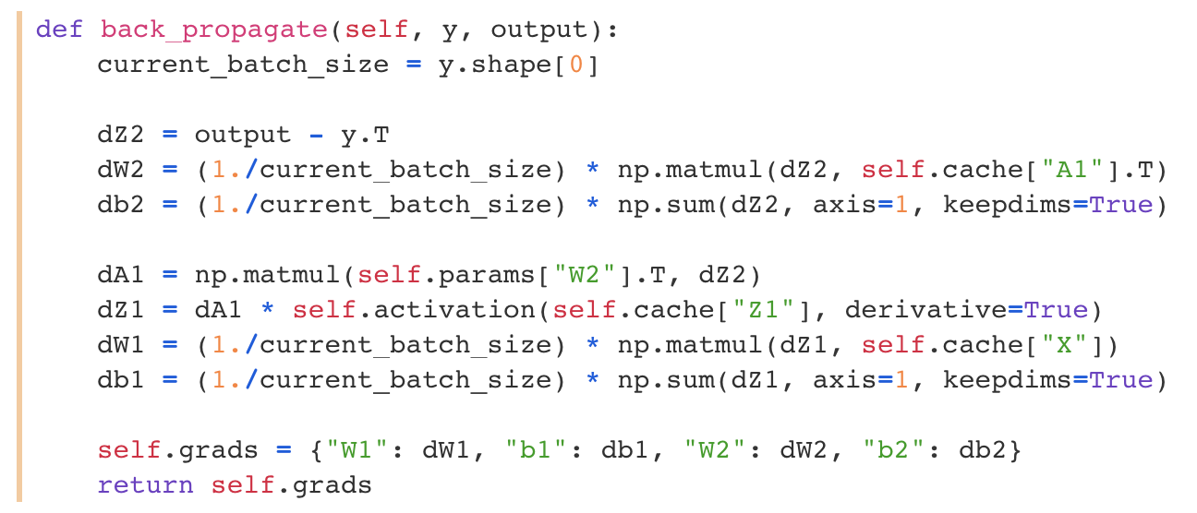

Slide 18
Training
We have defined a forward and backward pass, but how can we start using them?
We have to make a training loop and choose an optimizer to update the parameters of the neural network

Slide 19
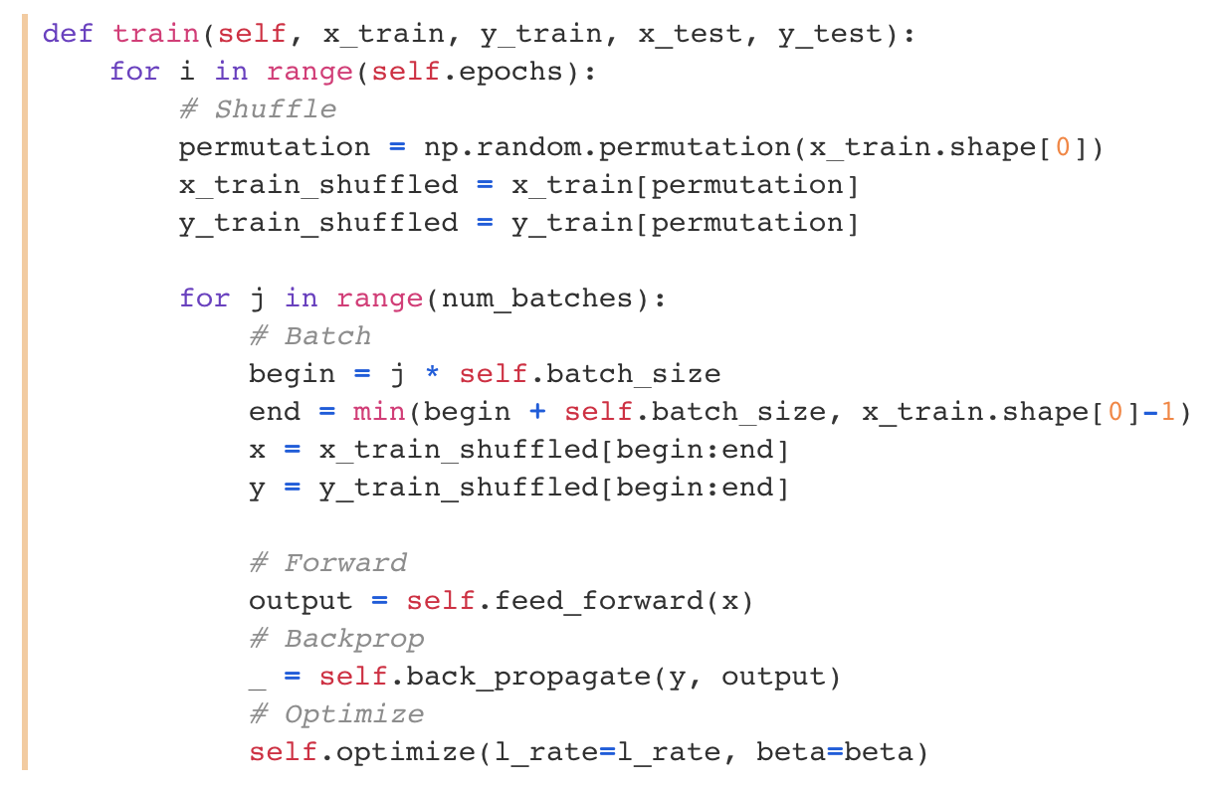
Training
Number of epochs
Running through each batch
Compute predictions
Compute gradients
Update networks
Notes:
看過一次 dataset 是完成一個 epoch

Slide 20
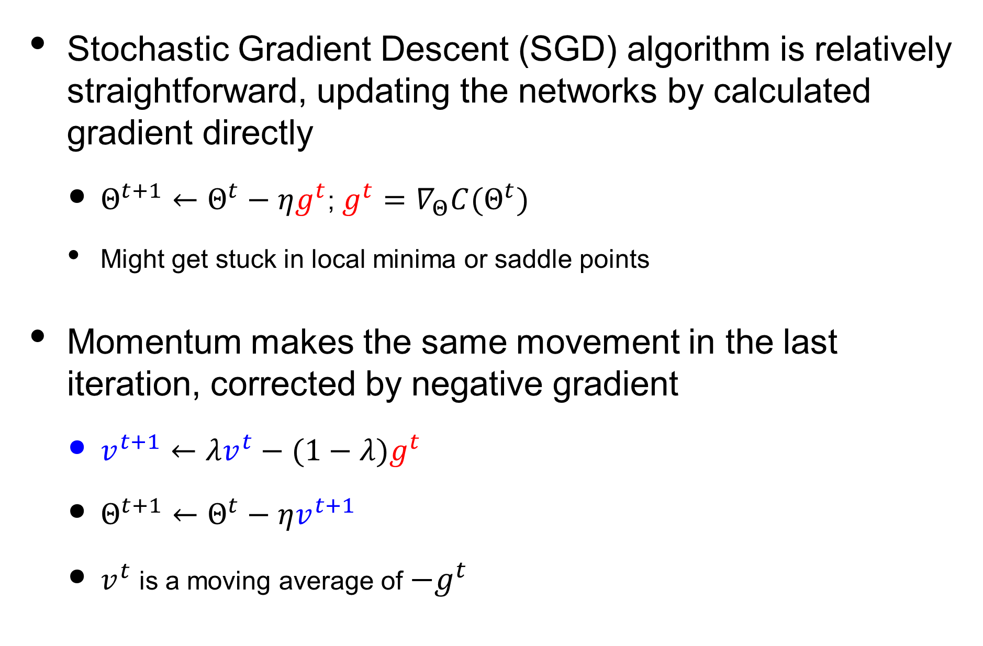
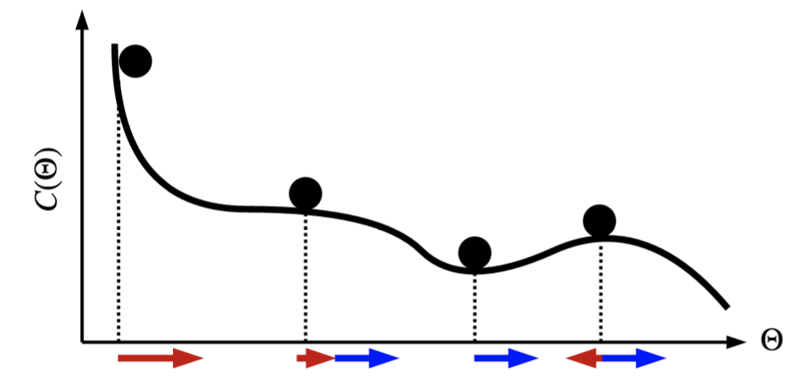
Optimization

Slide 21
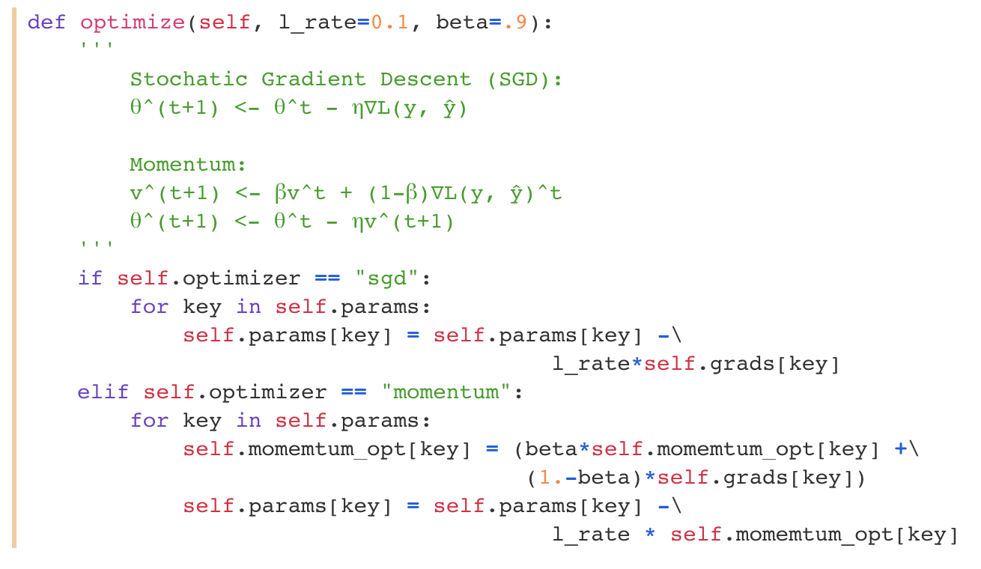
Optimization

Slide 22
Results
The results completely dependent on how the weights are initialized and the activation function we use
Experimentally, due to non-bounded behavior of relu(), the learning rate should be set much smaller than the one for sigmoid() (bounded)
Training with SGD optimizer with momentum should have better result since it avoids from getting stuck in local minima or saddle points
The reason behind this phenomenon is complicated and beyond the scope of this class. In short, the training results will be more stable and consistent as the batch size increases

Slide 23
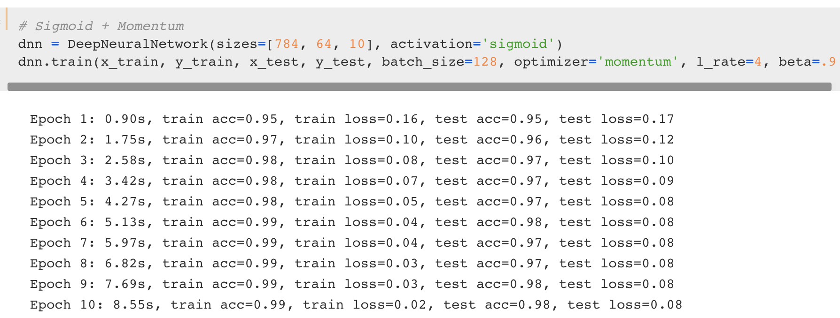
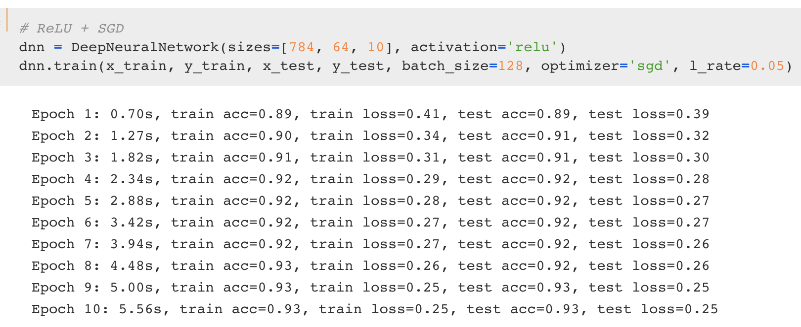
Sigmoid + Momentum optimizer
ReLU + SGD optimizer

Slide 24
Outline
Neural Networks from Scratch
Why TensorFlow?
Environment Setup
TensorFlow 2 Quickstart
Dataset Preparation
Building Model via Sequential API, Functional API, and Model Subclassing
Better performance with tf.function
Customize gradient flow by tf.custom_gradient

Slide 25





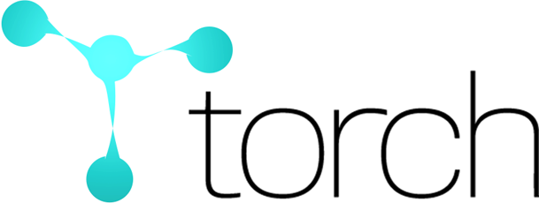
Deep Learning Framework

Slide 26


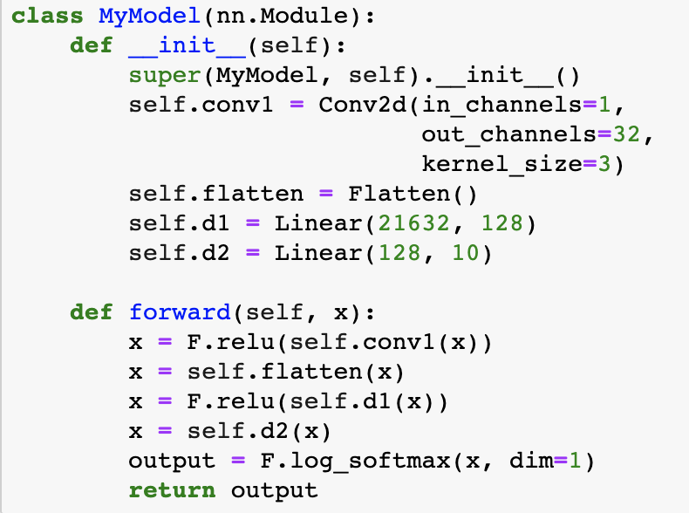
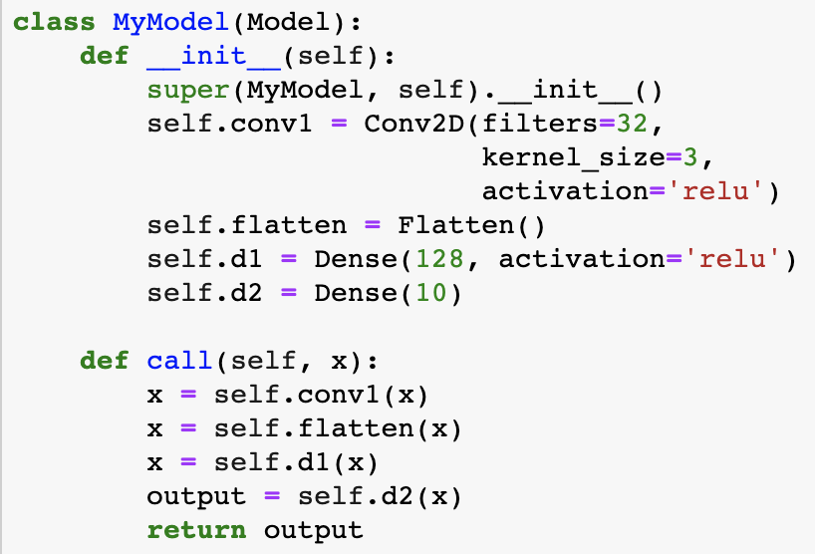
TensorFlow v.s. PyTorch
The two frameworks had a lot of major differences in terms of design, paradigm, syntax, etc till some time back
But they have since evolved a lot, both have picked up good features from each other and are no longer that different

Slide 27
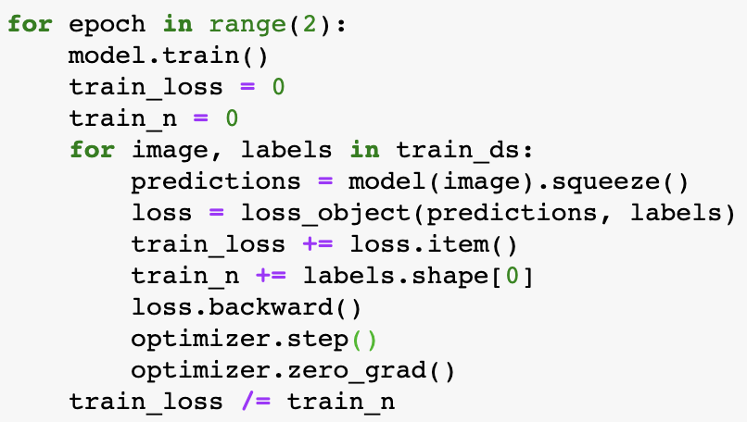
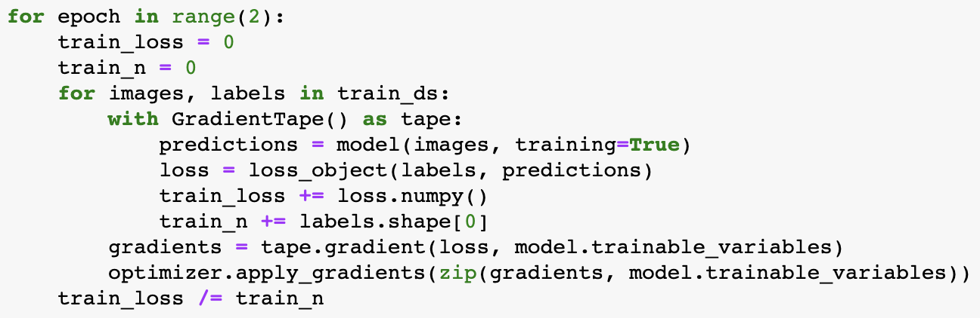
TensorFlow v.s. PyTorch

Slide 28
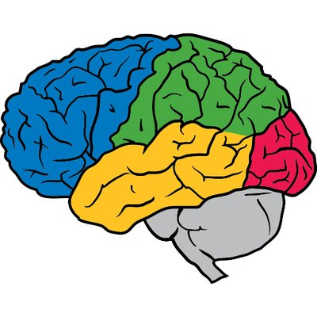
TensorFlow
Originally developed by Google Brain, TensorFlow is an end-to-end open source platform for machine learning, which has several benefits:
Easy model building
Robust ML production anywhere
Powerful experimentation for research

Slide 29
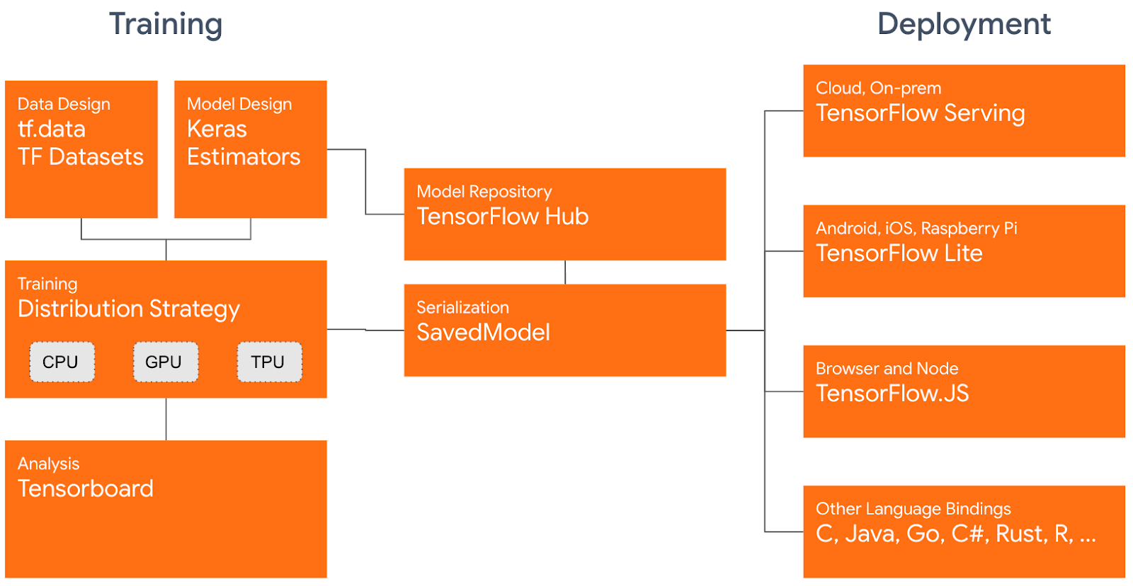
TensorFlow

Slide 30
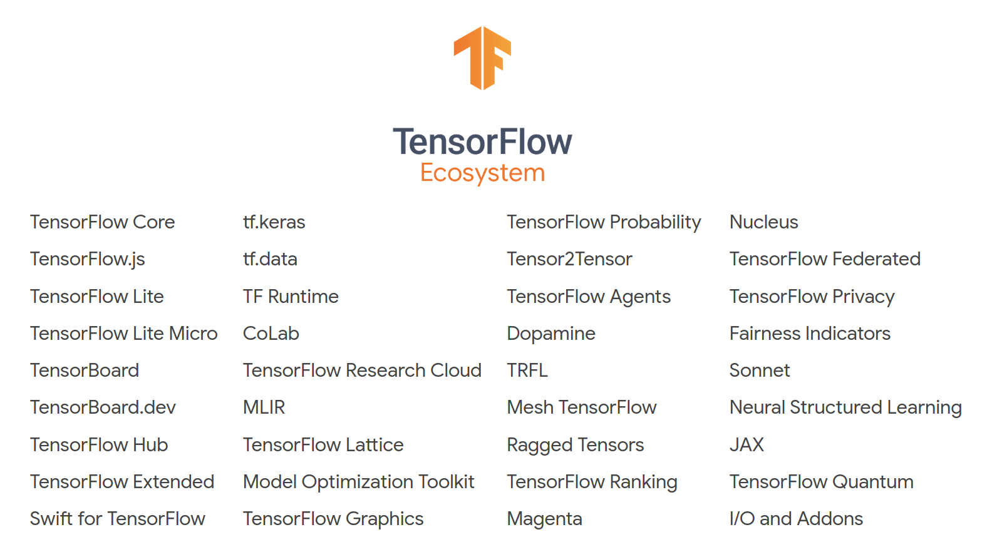

Slide 31
Outline
Neural Networks from Scratch
Why TensorFlow?
Environment Setup
TensorFlow 2 Quickstart
Dataset Preparation
Building Model via Sequential API, Functional API, and Model Subclassing
Better performance with tf.function
Customize gradient flow by tf.custom_gradient

Slide 32
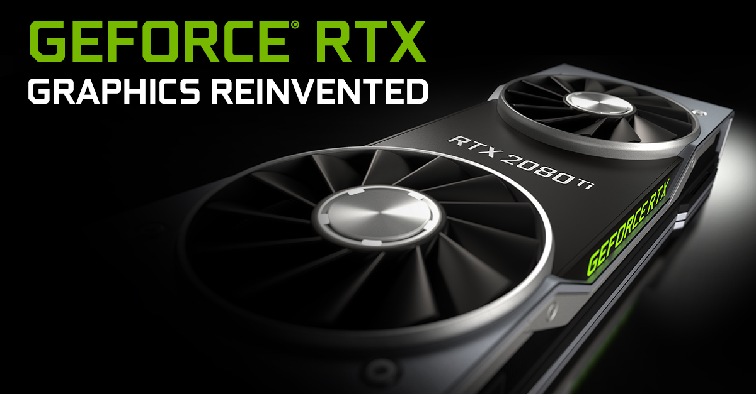
Software requirements
Before using TensorFlow, the following NVIDIA® software must be installed on your system:
NVIDIA® GPU drivers —CUDA® 11.x requires 450.xx or higher
CUDA® Toolkit —TensorFlow supports CUDA® 11.0 (TensorFlow >= 2.4.0)
CUPTI ships with the CUDA® Toolkit
cuDNN SDK 8.9.5 (see cuDNN versions)
(Optional) TensorRT 8.0 to improve latency and throughput for inference on some models

Slide 33
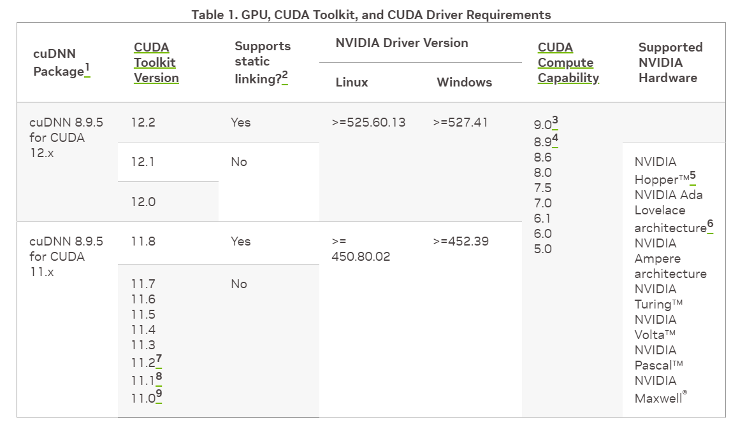
Software requirements
LINK

Slide 34
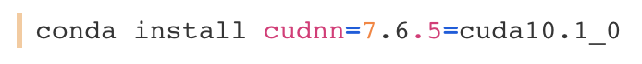
Install CUDA
Please refer to TensorFlow website, GPU Support section, for more details and latest information
Please check the version of the abovementioned softwares carefully. There is a strict requirement between TensorFlow's version and NVIDIA® softwares’
(Optional) If you are using Anaconda environment, you can install corresponding CUDA Toolkit and cuDNN SDK via
Notice that you still have to install NVIDIA® GPU drivers manually

Slide 35
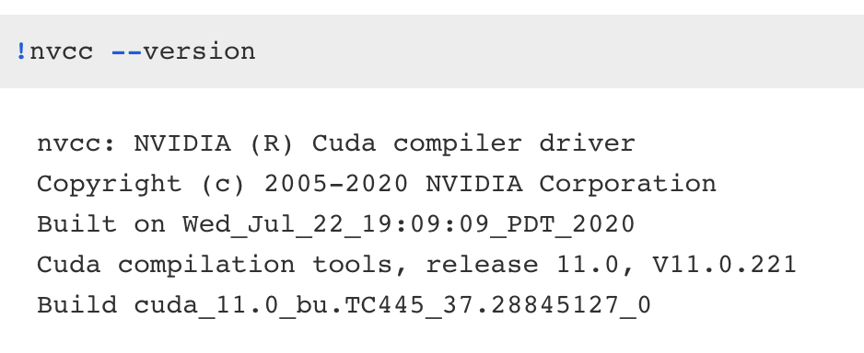
Environment Setup
After installing CUDA Toolkit, you can check CUDA version with nvcc --version

Slide 36
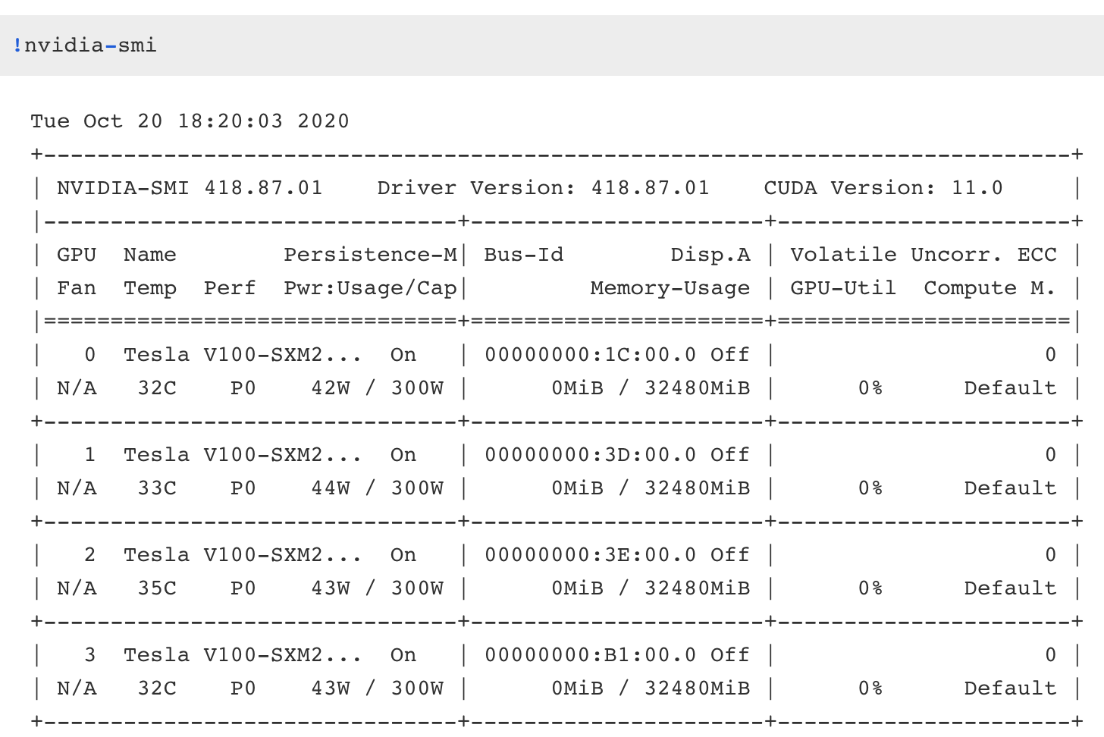
Environment Setup
You can also check GPU utilization after installing GPU driver with nvidia-smi

Slide 37
Install TensorFlow 2
TensorFlow is tested and supported on the following 64-bit systems:
Python 3.5–3.8
Ubuntu 16.04 or later
macOS 10.12.6 (Sierra) or later (no GPU support)
Windows 7 or later
Raspbian 9.0 or later

Slide 38
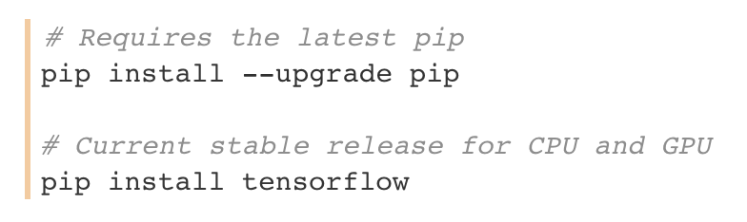
Install TensorFlow 2
We can simply install TensorFlow with Python's pip package manager
It is recommanded to install TensorFlow in a virtual environment, for more details, please refer to Install TensorFlow with pip

Slide 39
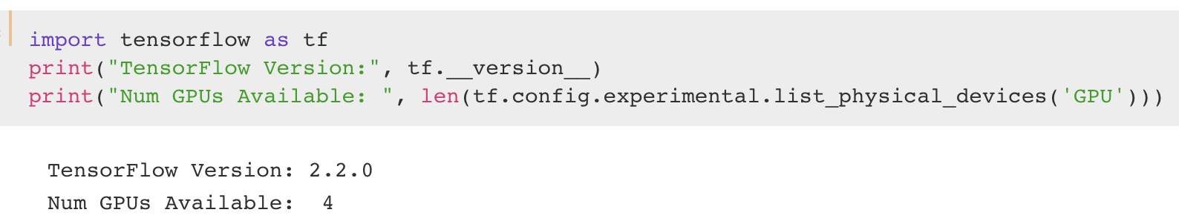
Install TensorFlow 2
We can test whether TensorFlow is installed successfully and confirm that TensorFlow is using the GPU by executing following code

Slide 40

Google Colab
Google Colab provides a Jupyter notebook environment that requires no setup with free GPU
The types of GPUs available in Colab vary over time, including Nvidia K80, T4, P4, P100
There is no way to choose what type of GPU you can connect to in Colab at any given time
However, there are few constraints when using Google Colab:
12 hours lifetimes limit
Various available GPU memory
Google announced a new service called Colab Pro ($9.99/month), which provides faster GPUs, longer runtimes, and more memory compared with Colab

Slide 41
Outline
Neural Networks from Scratch
Why TensorFlow?
Environment Setup
TensorFlow 2 Quickstart
Dataset Preparation
Building Model via Sequential API, Functional API, and Model Subclassing
Better performance with tf.function
Customize gradient flow by tf.custom_gradient

Slide 42
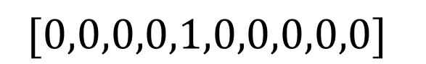
TensorFlow 2 Quickstart
Later on you will learn how to build a simple deep neural network to classify hand-written digit numbers
This time with TensorFlow!
Input Layer (Flatten)
Hidden Layer, 784x64
Output Layer, 64x10

Slide 43
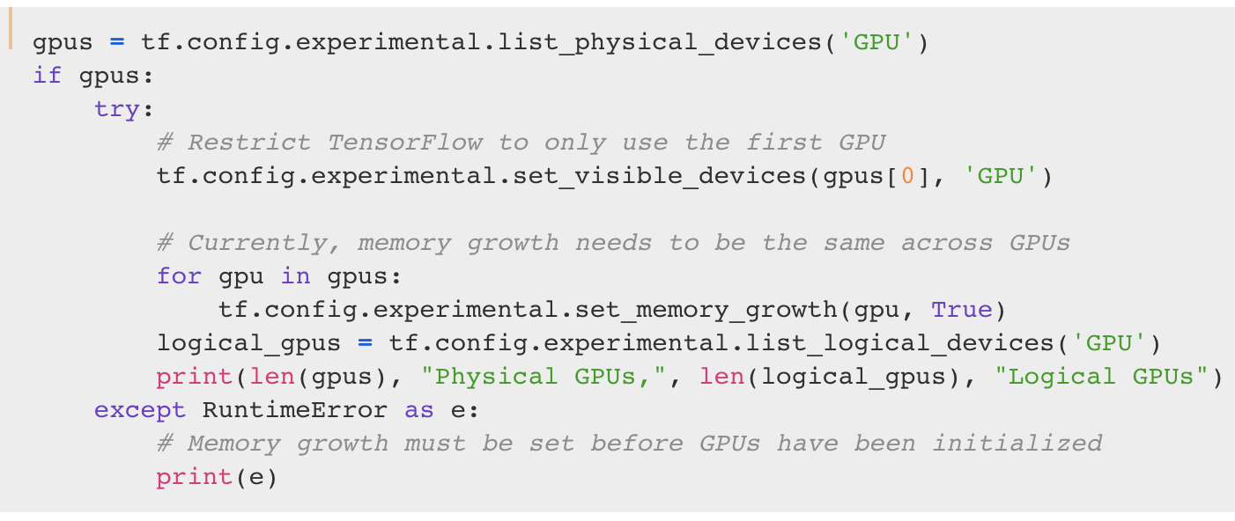
Limit GPU Memory Growth
By default, TensorFlow maps nearly all of the GPU memory of all GPUs visible to the process
This is done to more efficiently use the relatively precious GPU memory resources on the devices by reducing memory fragmentation
To limit a specific set of GPUs and to allocate a subset of the available memory, you can execute
Restrict GPU to use
Allocate subset
of memory

Slide 44
Outline
Neural Networks from Scratch
Why TensorFlow?
Environment Setup
TensorFlow 2 Quickstart
Dataset Preparation
Building Model via Sequential API, Functional API, and Model Subclassing
Better performance with tf.function
Customize gradient flow by tf.custom_gradient

Slide 45
Dataset Preparation
Currently, tf.keras.dataset supports 7 datasets. Including:
mnist module: MNIST handwritten digits dataset.
cifar10 module: CIFAR10 small images classification dataset.
cifar100 module: CIFAR100 small images classification dataset.
fashion_mnist module: Fashion-MNIST dataset.
imdb module: IMDB sentiment classification dataset.
boston_housing module: Boston housing price regression dataset.
reuters module: Reuters topic classification dataset.

Slide 46
Outline
Neural Networks from Scratch
Why TensorFlow?
Environment Setup
TensorFlow 2 Quickstart
Dataset Preparation
Building Model via Sequential API, Functional API, and Model Subclassing
Better performance with tf.function
Customize gradient flow by tf.custom_gradient

Slide 47
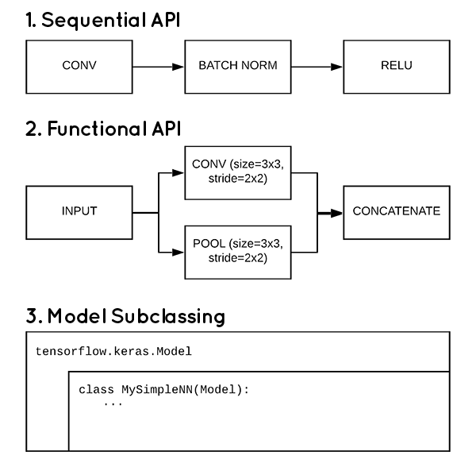
Build model via Sequential API
A Sequential API is the simplest way to build a model, which is appropriate for a plain stack of layers where each layer has exactly one input tensor and one output tensor

Slide 48
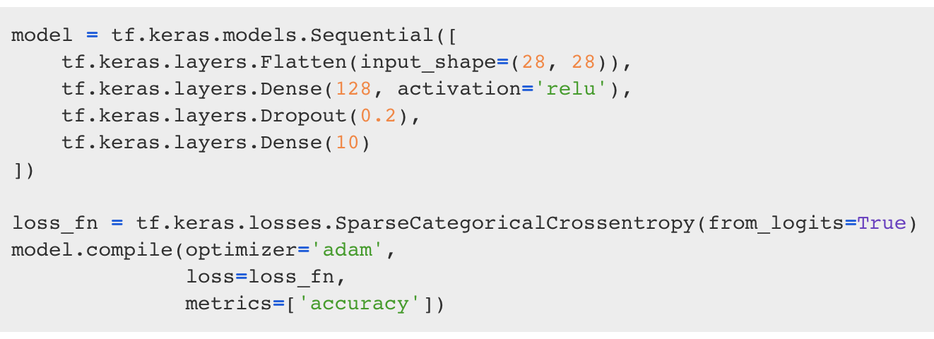
Build model via Sequential API
To classify MNIST, let’s build a simple neural network with fully-connected layers
Build the tf.keras.Sequential model by stacking layers. Choose an optimizer and loss function for training:
Model architecture
Loss function
Optimizer
Notes:
Dropout: 捨棄掉一些 hidden weight 防止 overfit
Adam: adagrap 跟 momentum 的結合，前者會隨 training time 調整 learning rate

Slide 49
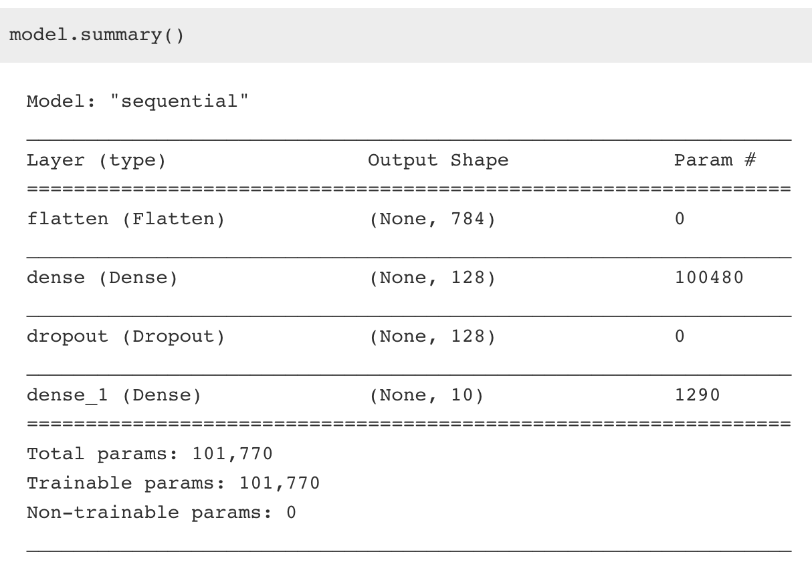
Build model via Sequential API
The Model.summary method prints a string summary of the network, which is quite useful to examining model architecture before training
= 784*128 + 128
= 128*10 + 10

Slide 50
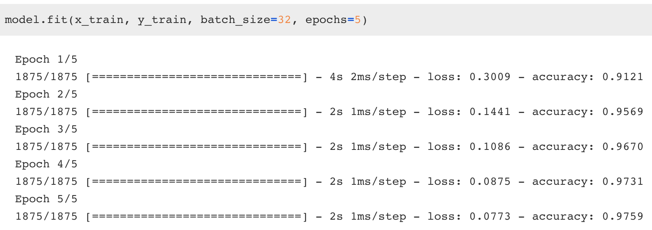
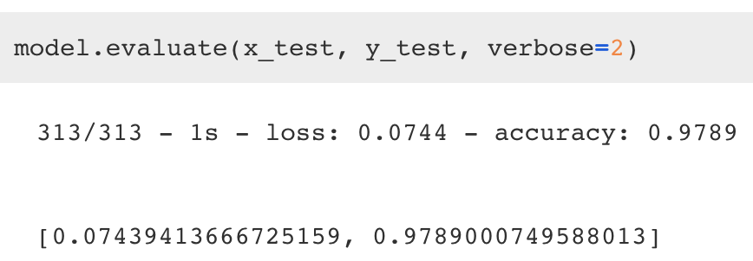
Build model via Sequential API
The Model.fit method adjusts the model parameters to minimize the loss:
The Model.evaluate method checks the models performance, usually on a "Validation-set" or "Test-set"

Slide 51
Build model via Functional API
The Keras Functional API is a way to create models that are more flexible than Sequential API
The functional API can handle models with non-linear topology, shared layers, and even multiple inputs or outputs

Slide 52
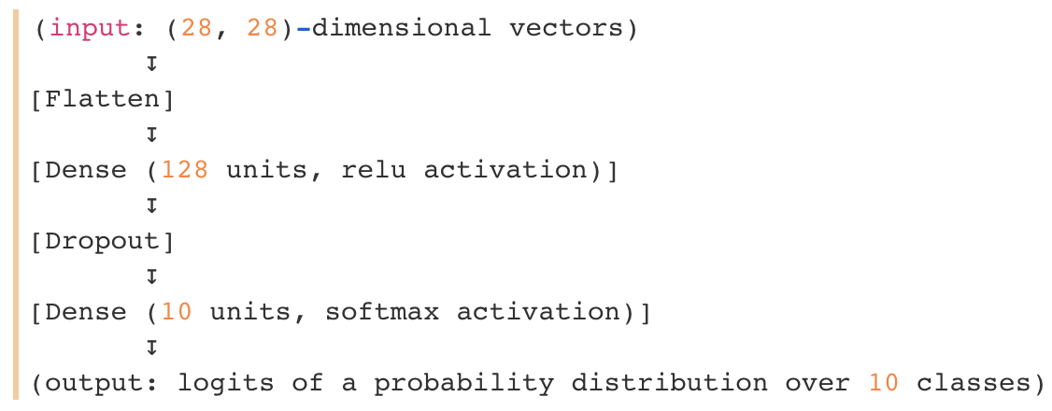
Build model via Functional API
The main idea is that a deep learning model is usually a directed acyclic graph (DAG) of layers. So the functional API is a way to build graphs of layers
Consider the following model:
This is a basic graph with four layers

Slide 53
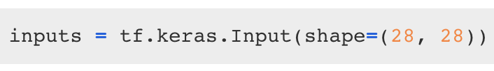
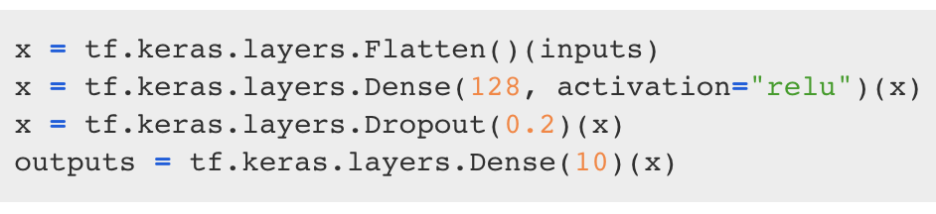
Build model via Functional API
Building model using the functional API by creating an input node first:
You create a new node in the graph of layers by calling a layer on this inputs object. The "layer call" action is like drawing an arrow from "inputs" to this layer you created

Slide 54
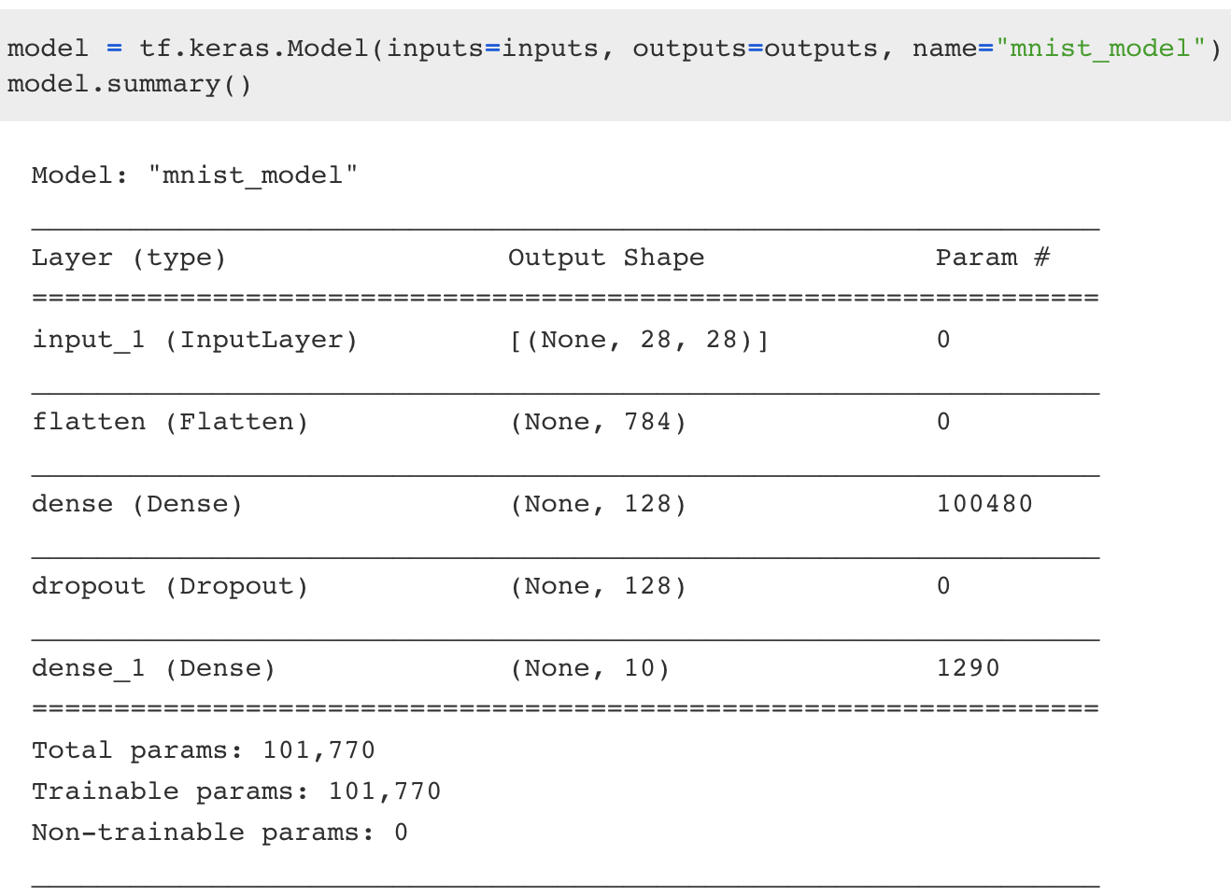
Build model via Functional API
At this point, you can create a Model by specifying its inputs and outputs in the graph of layers:
= 784*128 + 128
= 128*10 + 10

Slide 55
Build model via Model Subclassing
Model subclassing is fully-customizable and enables you to implement your own custom forward-pass of the model
However, this flexibility and customization comes at a cost — model subclassing is way harder to utilize than the Sequential API or Functional API

Slide 56
Build model via Model Subclassing
Exotic architectures or custom layer/model implementations, especially those utilized by researchers, can be extremely challenging
Researchers wish to have control over every nuance of the network and training process — and that’s exactly what model subclassing provides them

Slide 57
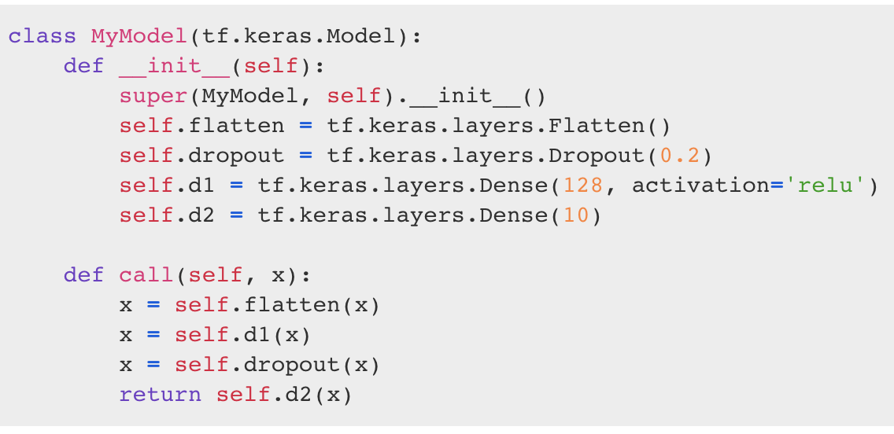
Build model via Model Subclassing
Build the model with Keras model subclassing API:
Model architecture
Forward path

Slide 58
Custom Training
You can always train the model with model.fit and model.evaluate, no matter which method you used to build the model
However, if you need more flexible training and evaluating process, you can implement your own methods

Slide 59
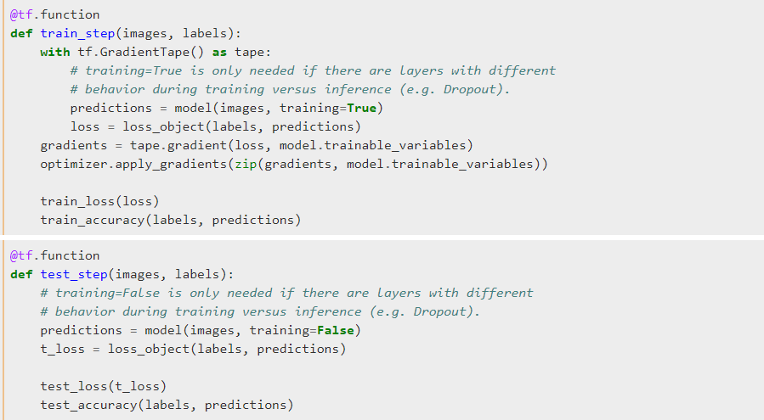
Training

Slide 60
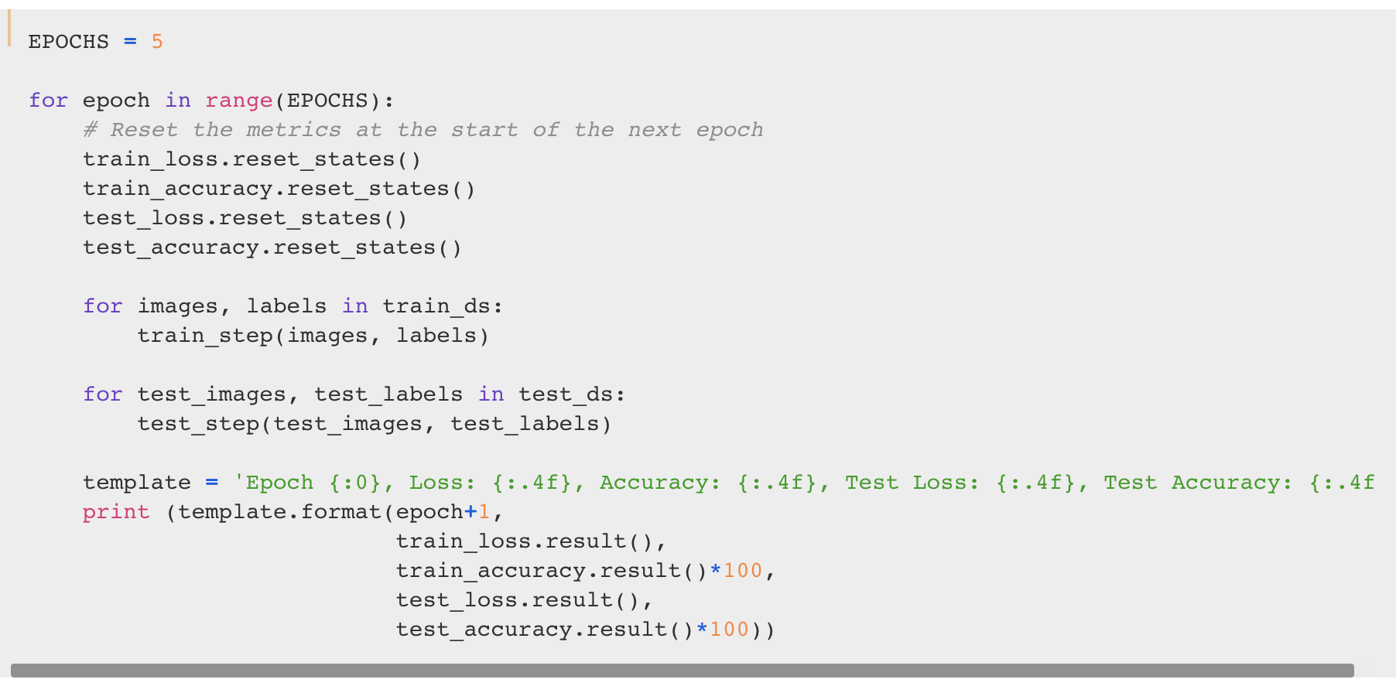
Custom Training
Number of epochs
Running through each batch

Slide 61
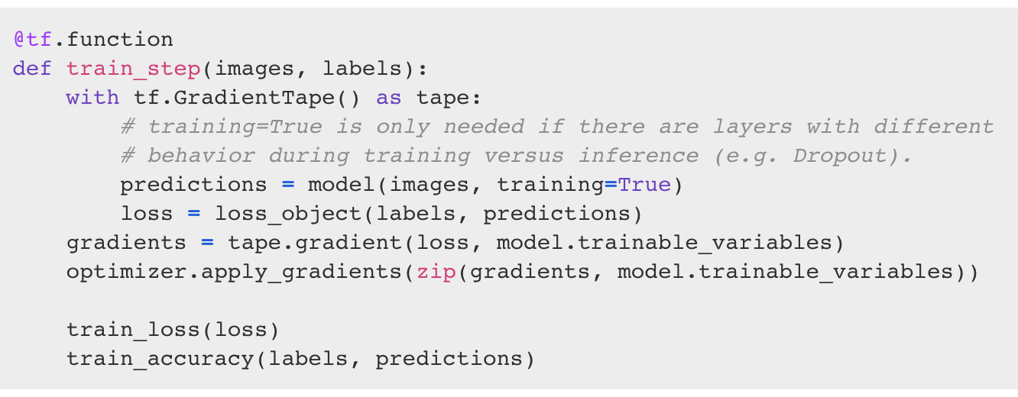
Custom Training
Similarly, you have to choose the loss function and optimizer as previous
Later on, to train the model, we can use tf.GradientTape to record operations for automatic differentiation
Boost performance
Compute predictions
Compute
gradients
Update networks
Notes:
Tf.GradientTape 會記錄正向傳播的內容，呼叫她的 gradient 即可反向計算 gradient

Slide 62

Gradients and Automatic Differentiation
One of the most important and powerful features of deep learning framework is automatic differentiation and gradients

Slide 63

Gradients and Automatic Differentiation
As we can see in Neural Networks from Scratch, building neural networks manually requires strong knowledge of backpropagation algorithm
It is interesting as we don't have too many operations or the model architecture is relatively simple
But what if we have this model?

Slide 64

Gradients and Automatic Differentiation
TensorFlow provides the tf.GradientTape API for automatic differentiation; that is, computing the gradient of a computation with respect to some inputs
In short, you can regard tape.gradient(loss, model.trainable_variable) as
Notes:
在 tf 裡面不用擔心 tape.gradient 會幫我們算好

Slide 65

Sequential API, Functional API, and Model Subclassing
Define Model Architecture
Define Loss and then Train

Slide 66
Sequential API, Functional API, and Model Subclassing
All models can interact with each other, whether they’re sequential models, functional models, or subclassed models
 | Sequential | Functional | Subclassing
Simple
Flexibility
1
2
3
3
2
1

Slide 67
Outline
Neural Networks from Scratch
Why TensorFlow?
Environment Setup
TensorFlow 2 Quickstart
Dataset Preparation
Building Model via Sequential API, Functional API, and Model Subclassing
Better performance with tf.function
Customize gradient flow by tf.custom_gradient

Slide 68
Better Performance with tf.function
In TensorFlow 2, eager execution is turned on by default. The user interface is intuitive and flexible
But this can come at the expense of performance and deployability
You can use tf.function to make graphs out of your programs. It is a transformation tool that creates Python-independent dataflow graphs out of your Python code
Notes:
把 tf.function 當成 decorator(裝飾器) 使用

Slide 69


Better Performance with tf.function
Let's create two function with same operation, one runs in eager and another runs in graph mode

Slide 70
Debugging
In general, debugging code is easier in eager mode than inside tf.function. You should ensure that your code executes error-free in eager mode first
Debug in eager mode, then decorate with @tf.function
Don't rely on Python side effects like object mutation or list appends
tf.function works best with TensorFlow ops; NumPy and Python calls are converted to constants
Notes:
Debug 的時候盡量用 eager mode 去 de 先不要加 decorator
盡量不要再透過 python 在外面去更改變數，都用 tf 的操作去改

Slide 71
Python Side Effects
Python side effects like printing, appending to lists, and mutating globals only happen the first time you call a function with a set of inputs
Afterwards, the traced tf.Graph is reexecuted, without executing the Python code
Notes:
因為如果我們有加 tf.function 那她會在第一次執行的時候就把 graph 建好，所以之後的 python code 就沒辦法影響他

Slide 72

Python Side Effects

Slide 73

Python Side Effects
Notes:
變成我們要透過 assign 的方式去更新他

Slide 74
Outline
Neural Networks from Scratch
Why TensorFlow?
Environment Setup
TensorFlow 2 Quickstart
Dataset Preparation
Building Model via Sequential API, Functional API, and Model Subclassing
Better performance with tf.function
Customize gradient flow by tf.custom_gradient

Slide 75
Customize Gradient Flow
tf.custom_gradient is a decorator to define a function with a custom gradient
This may be useful for multiple reasons, including providing a more efficient or numerically stable gradient for a sequence of operations

Slide 76





Customize Gradient Flow

Slide 77


Customize Gradient Flow
The gradient expression can be analytically simplified to provide numerical stability:

Slide 78
Reference
TensorFlow
3 ways to create a Keras model with TensorFlow 2.0
Pytorch vs Tensorflow in 2020

